Slide 1
Data Analysis on People’s Daily
-- Reform and Opening-up Policy in 2008 and 2018 based on word frequency
By JIANG Weiqi, YANG Lin, YAO Lan, ZHANG Huimin

Slide 2
Brief Introduction

Slide 3
2008 -- 30th Anniversary
2018 -- 40th Anniversary

Slide 4


Slide 5
Outline
- Comparison between 2008 and 2018 - Specific word frequency analysis in 2018 - Views of three political scientists in Hong Kong - Conclusion

Slide 6
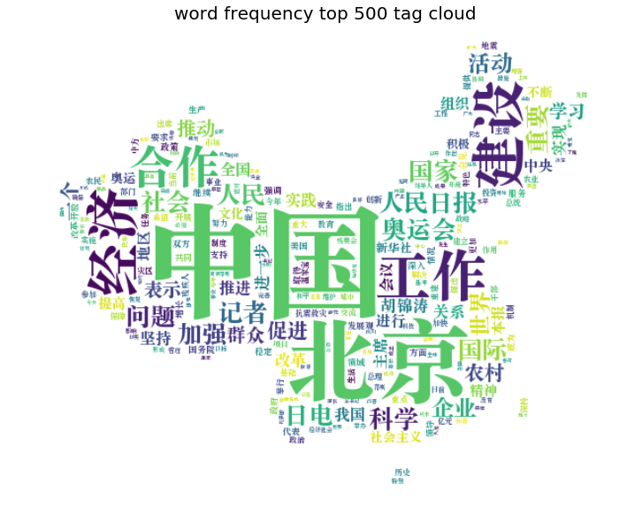
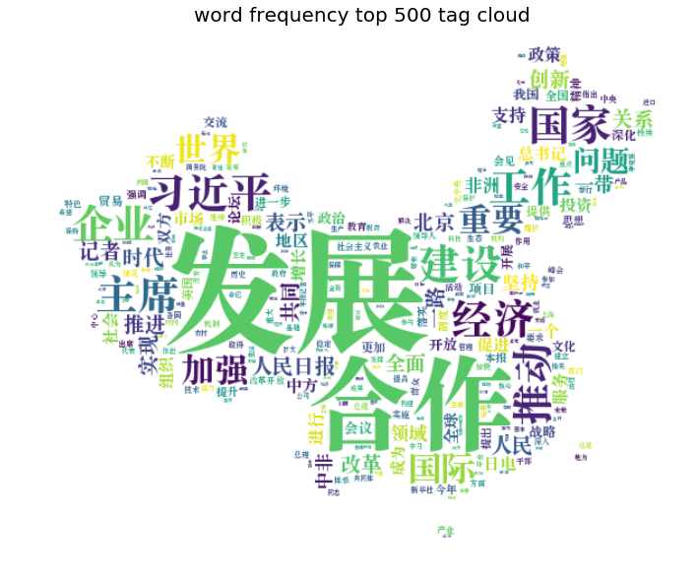
Tag Cloud in 2008 and 2018 （Top 500）
Earthquake
Olympic Games
Africa
Beijing
Development
China
Cooperation
July 1 to Dec. 31, 2008
July 1 to Dec. 31,2018

Slide 7
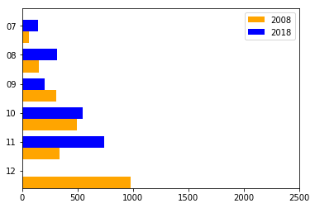
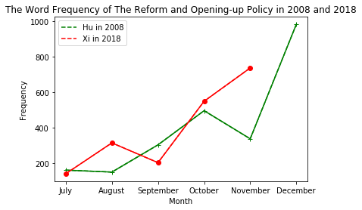
Reform and Opening-up Policy in 2008 and 2018
Histogram
Line Chart

Slide 8
“坚持以习近平新时代中国特色社会主义思想为指导，是确保改革开放既不走老路也不走邪路、在根本性问题上不犯颠覆性错误的重要前提。” ------人民网
To keep away from subversive mistakes on Reform and Opening-up Policy, we uphold Xi’s socialism with Chinese characteristics with which the party neither treading the old path nor go away on matters of principles. ----People’s Daily

Slide 9
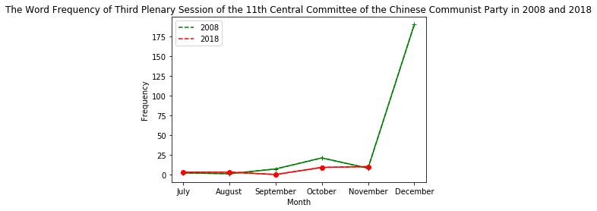

Slide 10
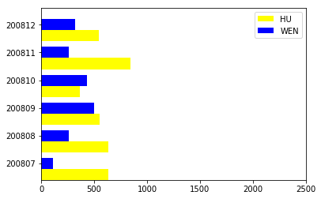
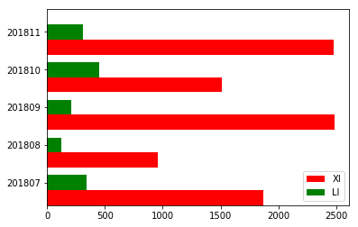
Frequency of Names
(President and Prime Minister)

Slide 11

https://www.nytimes.com/2016/05/25/world/asia/china-carl-minzner-xi-jinping.html?_ga=2.225813970.996136176.1543850922-952377570.1540603499

Slide 12
Three most important words about
policy under Xi Jinping’s administration
One belt one road
Greater bay area
Xi’s socialism with Chinese characteristics
Notes:
According to MING Kesheng, the three most important three words about the policy under Xi’s administration are …..
Therefore, we made word frequency analysis on the three words. Generally, frequency of using the three words has kept increasing from 2017 to 2018. Let’s discuss it in detail.

Slide 13
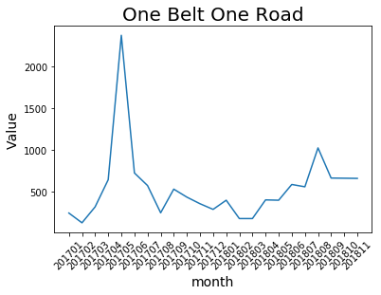
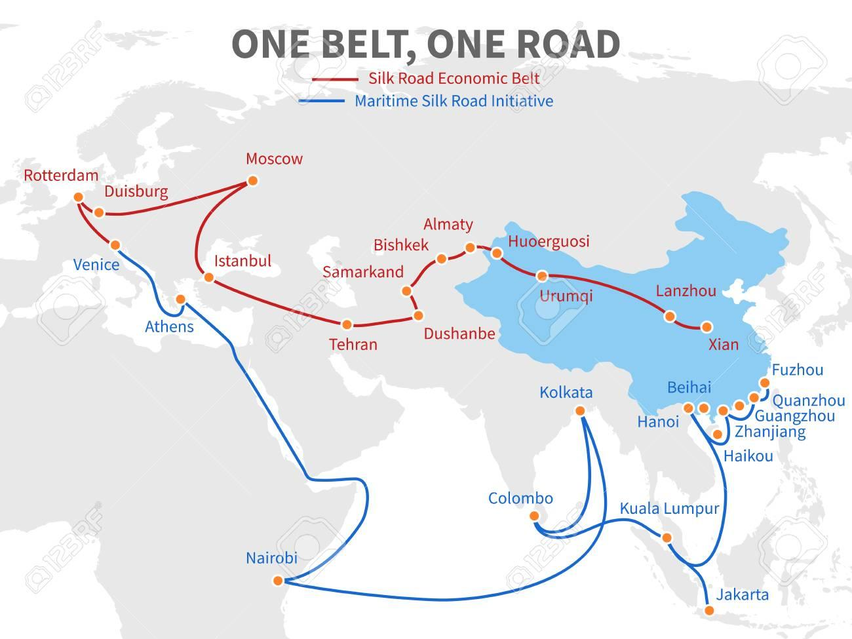
On May,14 & 15,
“One belt one road” forum was held in Beijing.
Notes:
, with prime ministers from 24 countries After that, “one belt one road” appears constantly.

Slide 14
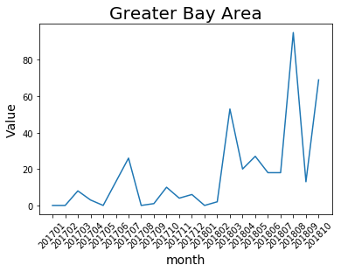
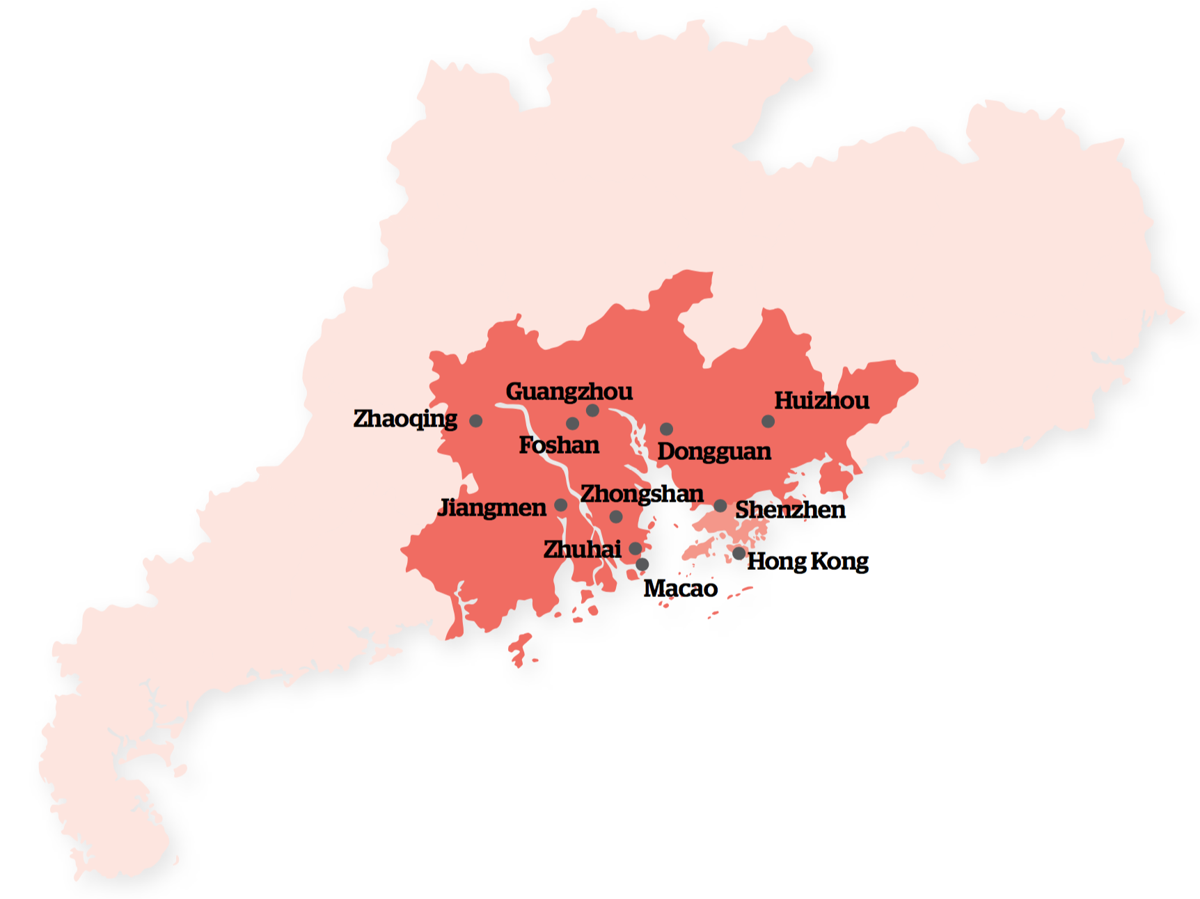
Notes:
Firstly mentioned in 201702. The relationship between mainland and Hong Kong became more and more intimate after 2018, July.On September, 23, mainland-Hong Kong high-speed rail opened. Witnessed Signing of the Framework Agreement for Deepening the Cooperation between Guangdong, Hong Kong and Macao to Promote the Construction of the Dawan District

Slide 15
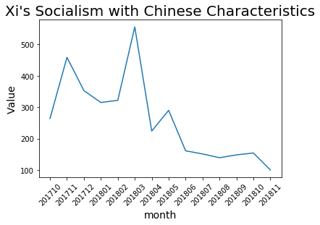
On 2017, October, 24, Xi’s socialism with Chinese characteristics was added into party constitution.
On March 11, 2018, Xi Jinping’s socialism with Chinese characteristics was written into the People’s Republic of China Constitution.
Notes:
during the closing ceremony of 19th CPC National Congress, the 13th National People’s Congress passed a Constitutional Amendment , Has become a word in high-frequency.

Slide 16
Experts’ opinions
and analysis

Slide 17
View1 Under the background of the decline of democracy worldwide, the Communist Party in China has demonstrated its ability to self-adjust and control the situation in a long period of time. It is possible for China to develop the liberal ideology, although it is a tough process.
View2 China’s reform and opening up have ended so far. The three main characteristics in past four decades：the rapid economic growth, relative openness in ideology, and correspondingly political stability have almost stopped.
View3 The Reform and Opening-up has added democratic characteristics in Chinese autocracy, and has made the rigid communist bureaucracy highly adapt to capitalist market economy. Although both China's "reform" and "opening" are changing both in theoretic and practical， what’s going on still partly depends on the respondency of the ruling party in the future.

Slide 18
Conclusion

Slide 19
Conclusion 1 China has changed a lot and this kind of transformation would be an constant phenomenon in a long period of time. Like the term “Reform and Opening-up”, the behind meaning in 2008 and 2018 is almost totally different.
Conclusion 2 Big data is useful to explore trend in abstract academic fields like political science, international relationship, or even for Kremlin scholars.

Slide 20
Thank you

